Slide 1
Statistics for Linguists
2023 01 17

Slide 2
Concepts for today
Review of basic concepts from linear models
Multilevel models

Slide 3
Multilevel model
What is a multilevel model?
An extension of the linear model where intercepts and/or slopes are random variables like x and y in normal linear models.

Slide 4

Linear models
A linear model constructs a model where y (dependent variable) increases linearly with x (independent variable).

Slide 5
Linear models
a is the intercept - where the line crosses 0 on the x axis
b is the slope of the line (it is a constant)
x (predictor variable) is a random variable (a set of numbers with a distribution)
y (dependent variable) is a random variable, but a function of the other variables
e (error) is a random variable. It is what makes the formula below a statistical model

Slide 6
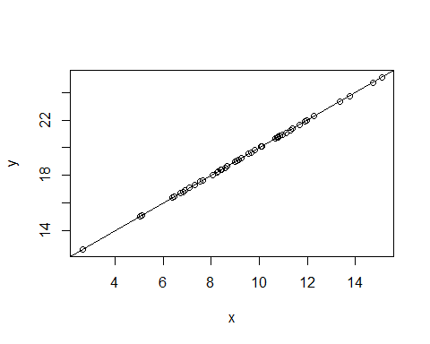
Linear model (perfect prediction)
x <- rnorm(50, m =10, sd = 3) a = 10 b = 1 y <- a+b*x plot(y~x) abline(coef(lm(y~x)))
Notes:
This is what the relationship between x and y looks like if there is no error term.

Slide 7
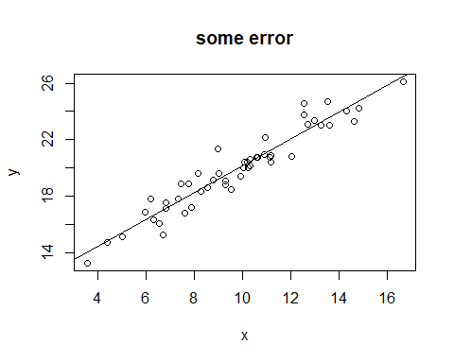
Linear model (some error)
x1 <- rnorm(50, m =10, sd = 3) a1 = 10 b1 =1 e1 <- rnorm(n=50, m=0, sd=1) #Add an error term y1 <- a1+b1*x1 +e1 data2 <- data.frame(x1,y1) plot(y1~x1) abline(coef(lm(y1~x1))) title("some error")

Slide 8
lm(y~x)
## ## Call: ## lm(formula = y ~ x) ## ## Coefficients: ## (Intercept) x ## 10.6101 0.9508

Slide 9
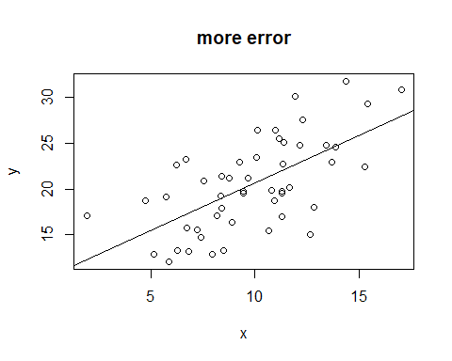
Linear model (more error)
x2 <- rnorm(50, m =10, sd = 3) a2 = 10 b2 =1 e2 <- rnorm(n=50, m=0, sd=4) y2 <- a2+b2*x2 +e2 data3 <- data.frame(x2,y2) data3$group = "large.residuals" plot(y2~x2) abline(coef(lm(y~x))) title("more error")

Slide 10
lm(y~x)
## ## Call: ## lm(formula = y ~ x) ## ## Coefficients: ## (Intercept) x ## 10.291 1.036

Slide 11
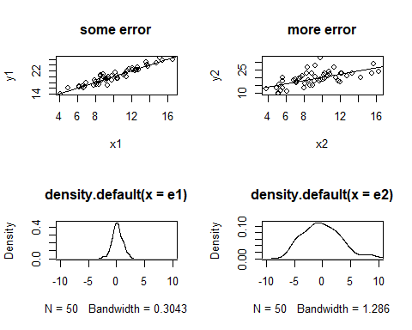
Linear models and error

Slide 12
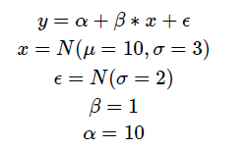
Reading R output
summary(lm(y1~x1))
## ## Call: ## lm(formula = y1 ~ x1) ## ## Residuals: ## Min 1Q Median 3Q Max ## -2.46443 -0.48623 -0.02705 0.49405 2.02559 ## ## Coefficients: ## Estimate Std. Error t value Pr(>|t|) ## (Intercept) 10.26454 0.49234 20.85 <2e-16 *** ## x1 0.98831 0.04702 21.02 <2e-16 *** ## --- ## Signif. codes: 0 '***' 0.001 '**' 0.01 '*' 0.05 '.' 0.1 ' ' 1 ## ## Residual standard error: 0.9142 on 48 degrees of freedom ## Multiple R-squared: 0.902, Adjusted R-squared: 0.9 ## F-statistic: 441.8 on 1 and 48 DF, p-value: < 2.2e-16

Slide 13
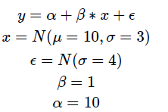
Reading R output
lm(y2~x2)
## ## Call: ## lm(formula = y2 ~ x2) ## ## Coefficients: ## (Intercept) x2 ## 10.2449 0.9903

Slide 14
Length of word and mean reaction time (from Levshina)
ldt <- read.csv("/Users/Adam/Desktop/levshina.ldt.csv", header=T) head(ldt)
## X Length Freq Mean_RT ## 1 marveled 8 131 819.19 ## 2 persuaders 10 82 977.63 ## 3 midmost 7 0 908.22 ## 4 crutch 6 592 766.30 ## 5 resuspension 12 2 1125.42 ## 6 efflorescent 12 9 948.33

Slide 15
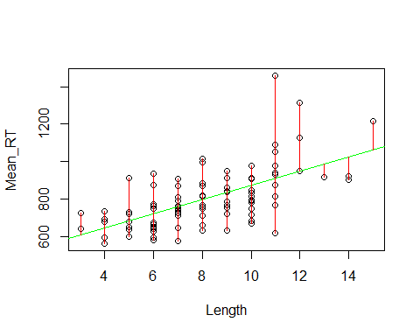

Residuals
Once a model is constructed, each y value can be associated with a residual, which is the distance between the value predicted by the line (the linear model) and the actual value.
attach(ldt) plot(Mean_RT~Length) abline(lm(Mean_RT~Length))
Notes:
Residuals are the red lines

Slide 16

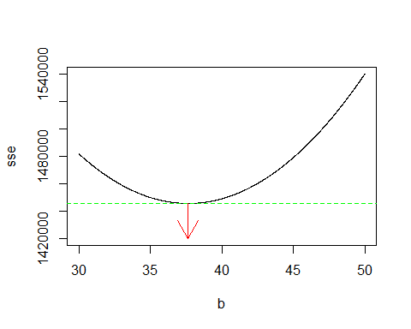
Linear model
A linear model chooses a slope (b) and an intercept (a) that gets the SSE as low as possible.
Sum of squared errors - the distances of the all the residuals added up

Slide 17
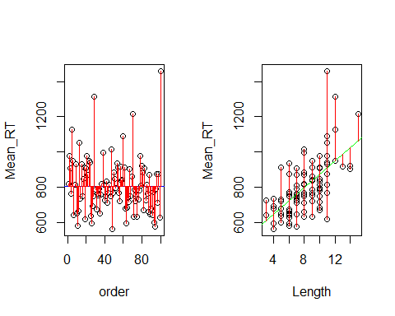
Linear model
The values from a linear model are basically comparing the sum of squared error of just the values of y, to the sum of squared error of the linear model.

Slide 18

Linear model
summary(lm(Mean_RT~Length))
## ## Call: ## lm(formula = Mean_RT ~ Length) ## ## Residuals: ## Min 1Q Median 3Q Max ## -291.74 -77.81 -3.69 47.92 546.22 ## ## Coefficients: ## Estimate Std. Error t value Pr(>|t|) ## (Intercept) 498.443 41.949 11.882 < 2e-16 *** ## Length 37.644 4.879 7.716 1.02e-11 *** ## --- ## Signif. codes: 0 '***' 0.001 '**' 0.01 '*' 0.05 '.' 0.1 ' ' 1 ## ## Residual standard error: 121.5 on 98 degrees of freedom ## Multiple R-squared: 0.3779, Adjusted R-squared: 0.3716 ## F-statistic: 59.53 on 1 and 98 DF, p-value: 1.019e-11

Slide 19
Phoneme inventory size vs. population size
using multilevel models
Research question:
“Is phoneme inventory size positively correlated with population size?”
Sources:
Steven Moran, Daniel McCloy, Richard Wright. 2012. Revisiting population size vs. phoneme inventory size. Language 88(4)
Atkinson. 2011. Phonemic Diversity Supports a Serial Founder Effect Model of Language Expansion from Africa. Science 332(6027)
Hay & Bauer. 2007. Phoneme inventory size and population size. Language 83(2)

Slide 20
Phoneme inventory size vs. population size
using multilevel models
Variables:
population size from Ethnologue
phoneme inventory size from PHOIBLE
language family affiliation (family from Multitree, genus from WALS)
coordinates
969 languages total

Slide 21
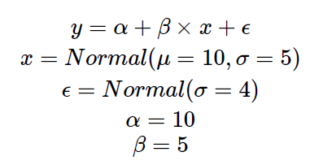
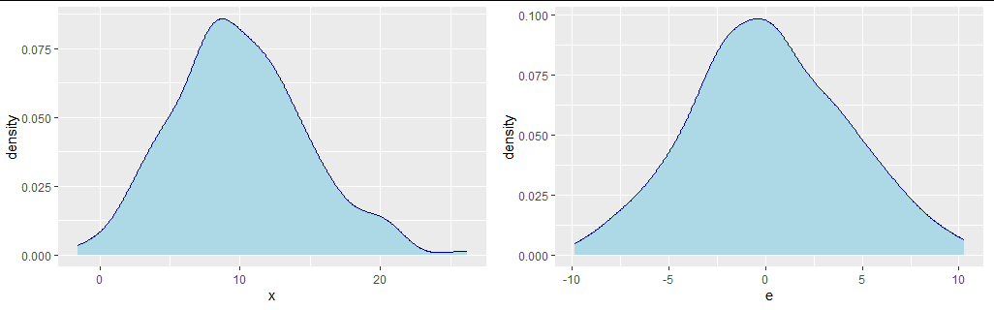
Multilevel / random effects model
Here is our linear model, with some made up constants and distributions

Slide 22
Multilevel / random effects model
Here is our linear model, with some made up constants and distributions

Slide 23
Multilevel / random effects model
The intercept and the slope are just constants they are fixed effects in the model

Slide 24
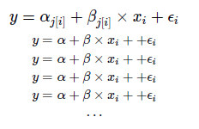
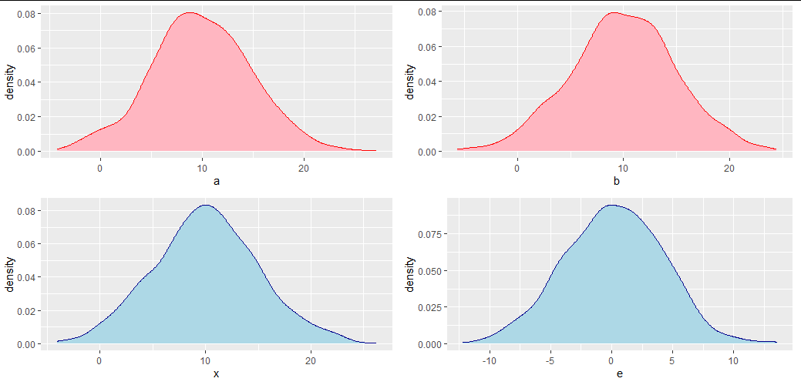
Multilevel / random effects model

Slide 25
Multilevel / random effects model

Slide 26
Multilevel / random effects model
Intercept and/or slope is a random variable (the effects of our original model are modelled as coming from a random distribution)
To model something as a random distribution we have to have multiple instances of it.
We have a bunch of linear regressions one for each “group” and the slopes and intercepts are allowed to vary according to some distribution.

Slide 27
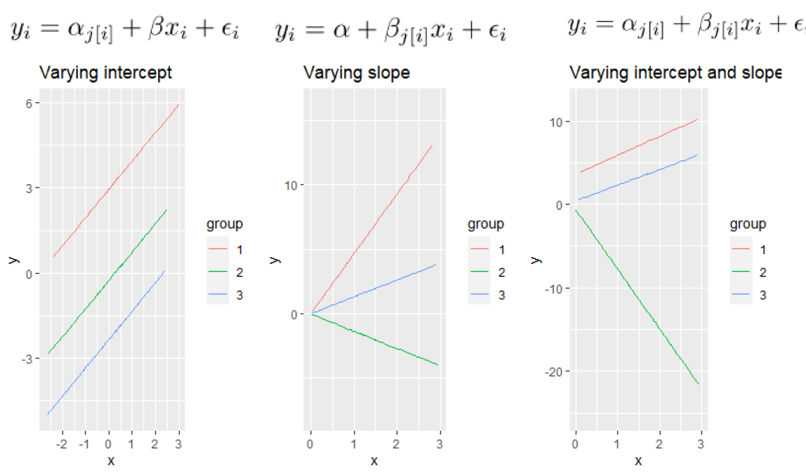
Multilevel / random effects model

Slide 28
Multilevel / random effects model
Why not just do lots of individual linear regressions?
You are doing lots of linear regressions, but then adjusting the values based on data across the groups
That is there is one level where each group gets its own linear regression, and then a higher level

Slide 29
Phoneme inventory by population size
There is a claim that phoneme inventory size increases with population size.
Indeed there is a cross-linguistic correlation.
But some of the early research didn’t take into account that both population size and inventory size vary substantially by linguistic area and linguistic family.

Slide 30
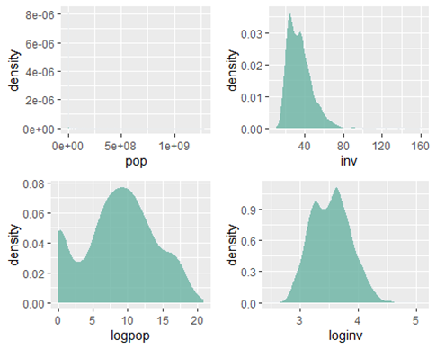
Phoneme inventory by population size
Some background - first we are going to use log transformed values of population size and inventory size.

Slide 31
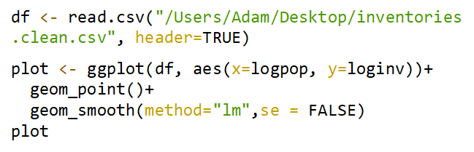
Phoneme inventory and population size

Slide 32
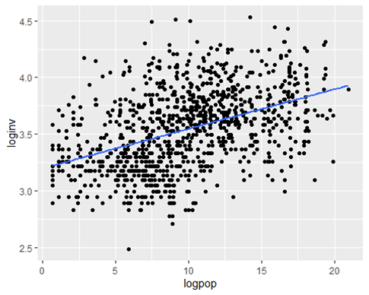
Phoneme inventory and population size

Slide 33
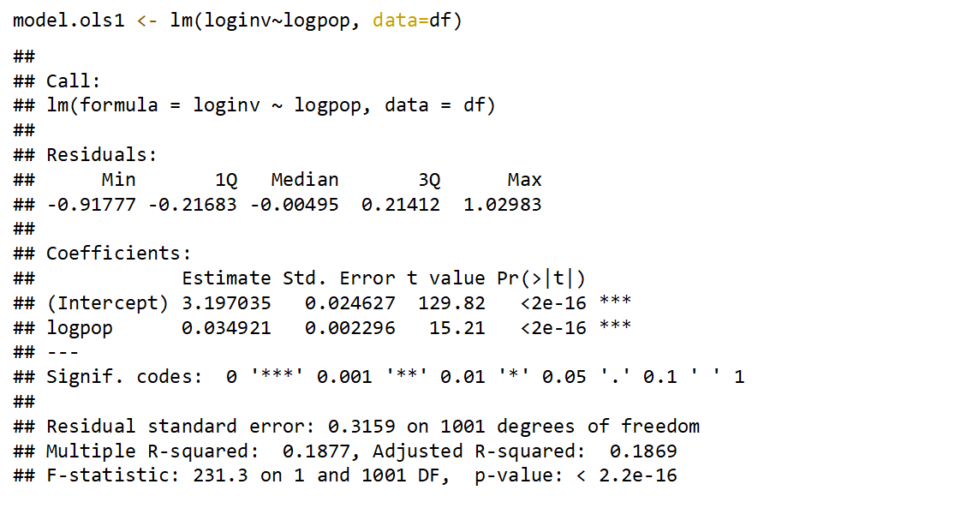

Slide 34
Language families

Slide 35
df.lgsubset <- subset(df3, family.name == "Indo-European"|
family.name =="Uto-Aztecan"|
family.name == "Atlantic-Congo"|
family.name == "Sino-Tibetan"|
family.name == "Otomanguean"|
family.name == "Austronesian"|
family.name == "Pama-Nyungan"|
family.name == "Austroasiatic"|
family.name =="Arawakan"|
family.name == "Pano-Tacanan")

Slide 36
df.lgsubset %>%
ggplot(aes(x=loginv,
y=logpop,
color=family.name))+
geom_point()+
geom_smooth(method="lm",se = FALSE)

Slide 37
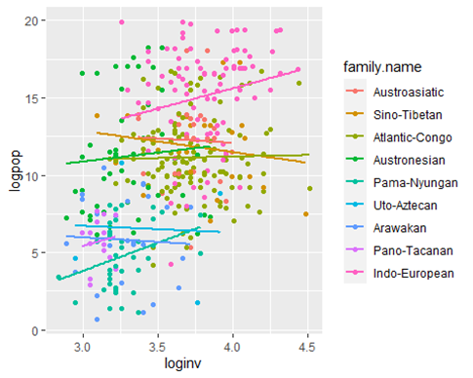

Slide 38
plot <- ggplot(df.lgsubset, aes(x=loginv, y=logpop, group=family.name))+
geom_point()+
geom_smooth(method="glm",se = FALSE)
plot + facet_wrap(~ family.name, ncol=3)

Slide 39
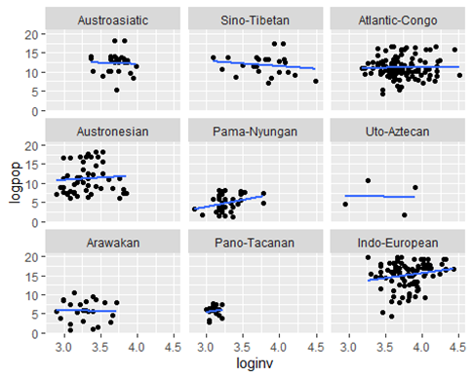

Slide 40
df.areasubset <- subset(df3, area !="")
plot <- ggplot(df.areasubset, aes(x=loginv, y=logpop, group=area))+
geom_point()+
geom_smooth(method="glm",se = FALSE)
plot + facet_wrap(~ area, ncol=3)

Slide 41
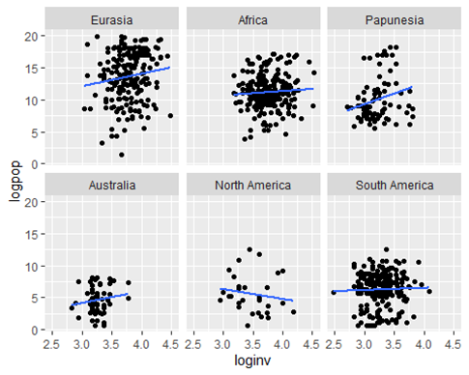

Slide 42
You need the following packages to run the code we’re going to run
library(lme4)
library(lmerTest)

Slide 43
mod.lmer.a <- lmer(loginv~logpop+(1|family.name)+(1|area), data=df)
mod.lmer.ab <- lmer(loginv~logpop+(1+logpop|family.name) + (1+logpop|area),data=df)
Notes:
First model varies just the intercept and the second model varies the intercept and the slope.

Slide 44
## Random effects:
## Groups Name Variance Std.Dev.
## family.name (Intercept) 0.01817 0.1348
## area (Intercept) 0.05347 0.2312
## Residual 0.05517 0.2349
## Number of obs: 807, groups: family.name, 104; area, 7
##
## Fixed effects:
## Estimate Std. Error df t value Pr(>|t|)
## (Intercept) 3.416e+00 9.657e-02 6.766e+00 35.374 6.24e-09 ***
## logpop 6.982e-03 2.986e-03 8.049e+02 2.338 0.0196 *
## ---
## Signif. codes: 0 '***' 0.001 '**' 0.01 '*' 0.05 '.' 0.1 ' ' 1
##
## Correlation of Fixed Effects:
## (Intr)
## logpop -0.266

Slide 45
## Random effects:
## Groups Name Variance Std.Dev. Corr
## family.name (Intercept) 1.763e-02 0.1327606
## logpop 9.276e-08 0.0003046 1.00
## area (Intercept) 5.624e-02 0.2371576
## logpop 4.671e-07 0.0006835 -1.00
## Residual 5.514e-02 0.2348129
## Number of obs: 807, groups: family.name, 104; area, 7
##
## Fixed effects:
## Estimate Std. Error df t value Pr(>|t|)
## (Intercept) 3.416e+00 9.876e-02 5.811e+00 34.586 5.94e-08 ***
## logpop 7.133e-03 2.994e-03 2.331e+02 2.382 0.018 *
## ---
## Signif. codes: 0 '***' 0.001 '**' 0.01 '*' 0.05 '.' 0.1 ' ' 1
##
## Correlation of Fixed Effects:
## (Intr)
## logpop -0.342

Slide 46
coef(mod.lmer.ab)

Slide 47
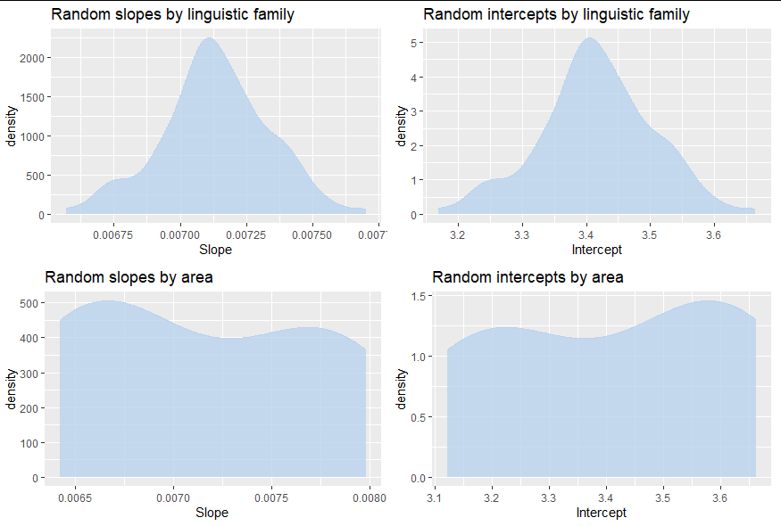

Slide 48
Some more advanced stuff (model comparison)
mod.lmer.null1 <- lmer(loginv~(1|family.name)+ (1|area), data=df)
mod.lmer.null2 <- lmer(loginv~(1|family.name), data=df)
mod.lmer.null3 <- lmer(loginv~(1|area), data=df)
anova(mod.lmer.null1,
mod.lmer.null2,
mod.lmer.null3)

Slide 49
Some more advanced stuff (model comparison)
mod.lmer.a <- lmer(loginv~logpop+(1|family.name)+(1|area), data=df)
mod.lmer.ab <- lmer(loginv~logpop+(1+logpop|family.name) + (1+logpop|area),data=df)
anova(mod.lmer.null1, mod.lmer.a, mod.lmer.ab)

